Slide 1


PROTOCOL DAN ARSITEKTUR
OSI dan TCP/IP
DOSEN PENGAMPU
MARDIANTO,S.Kom.,M.Cs

Slide 2
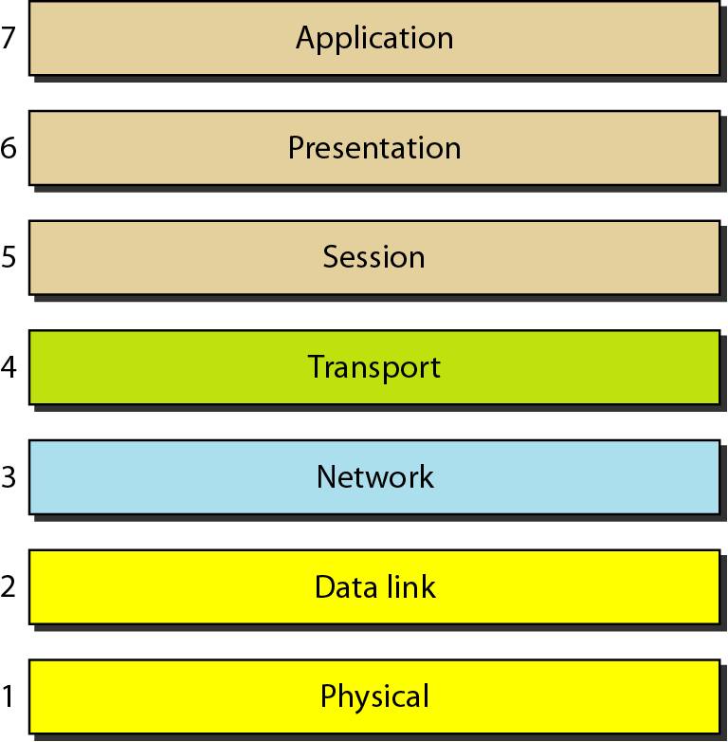
Seven layers of the OSI model

Slide 3
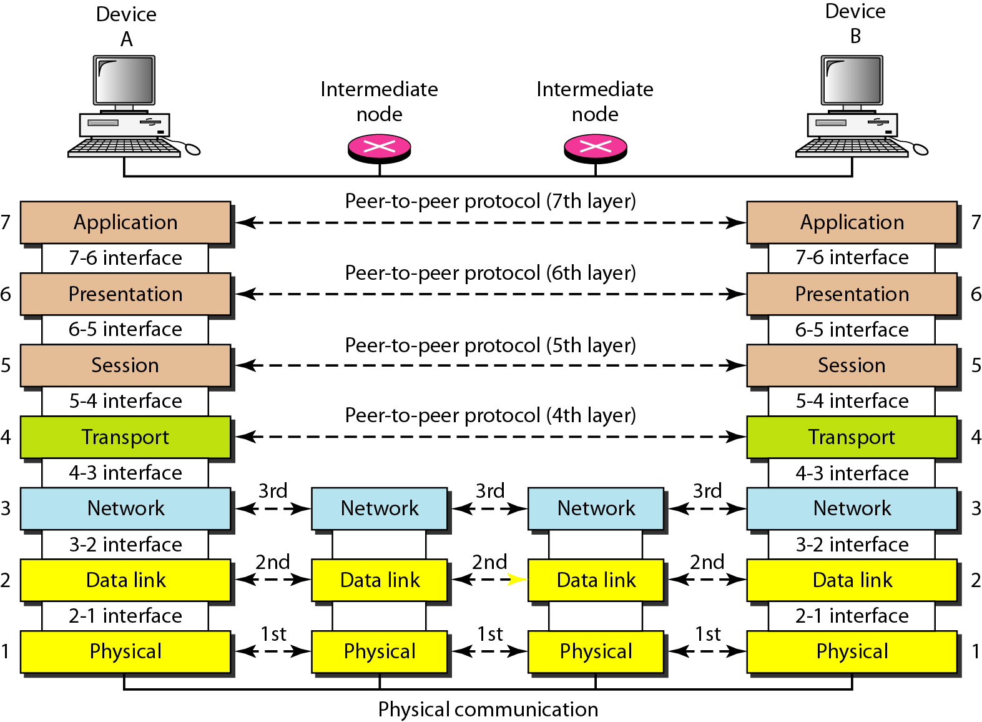
The interaction between layers in the OSI model

Slide 4
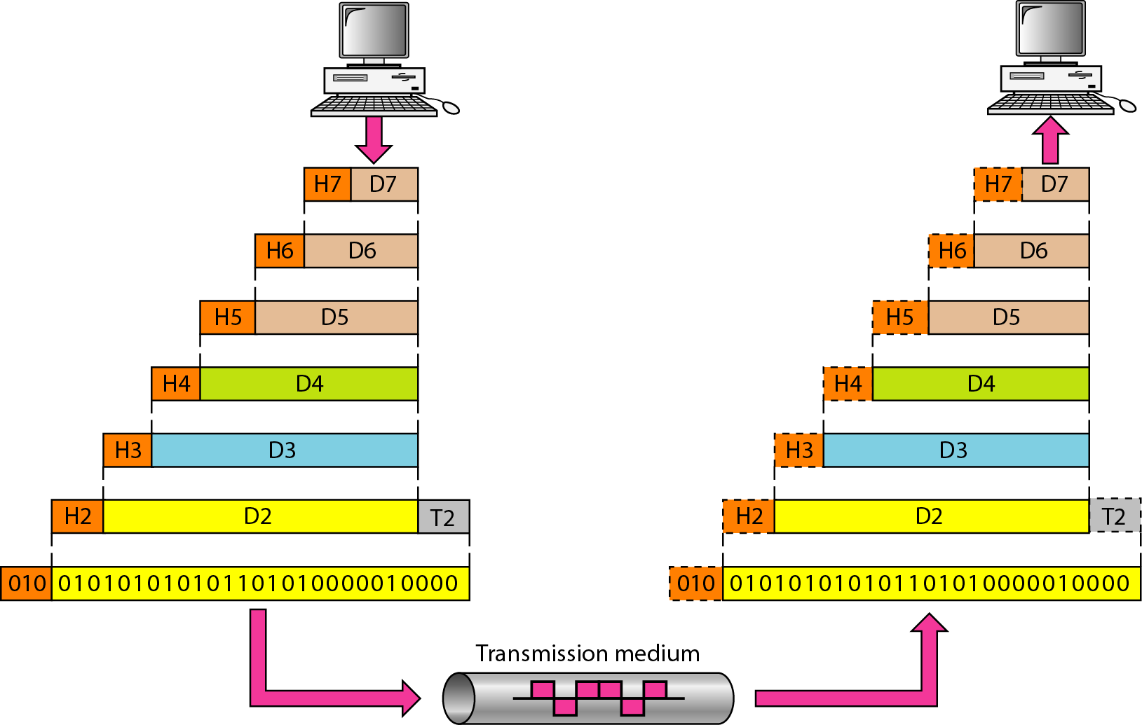
An exchange using the OSI model

Slide 5
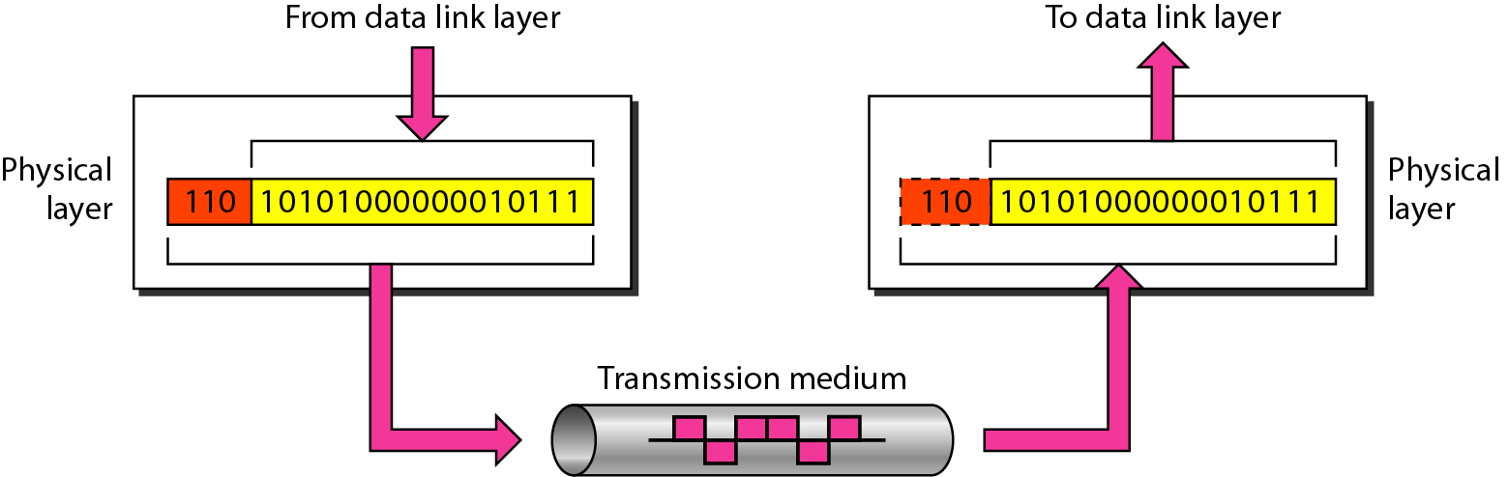
Physical layer

Slide 6
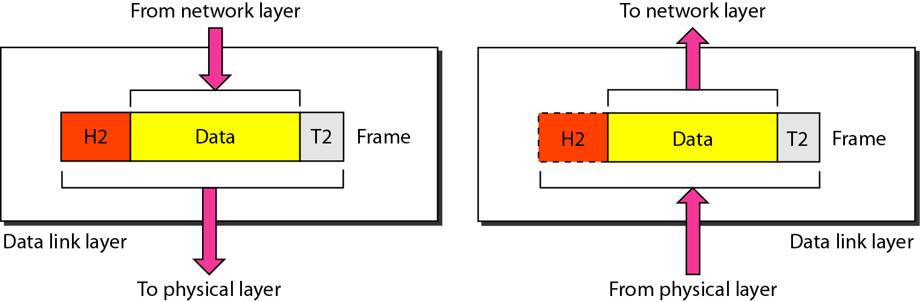
Data link layer

Slide 7
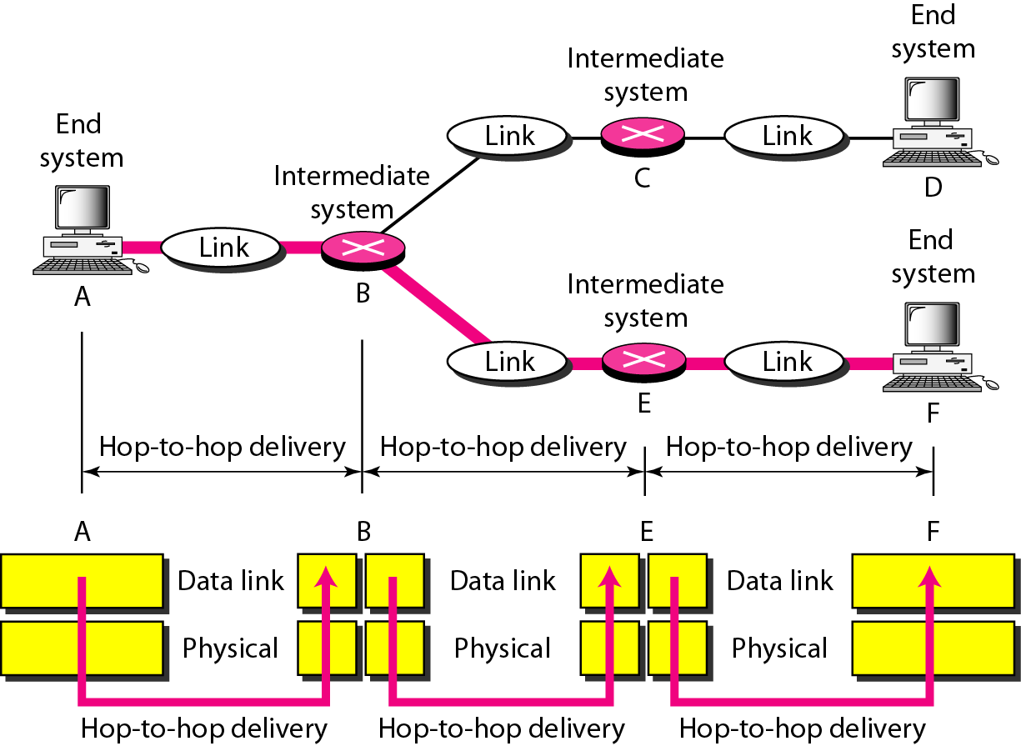

Slide 8
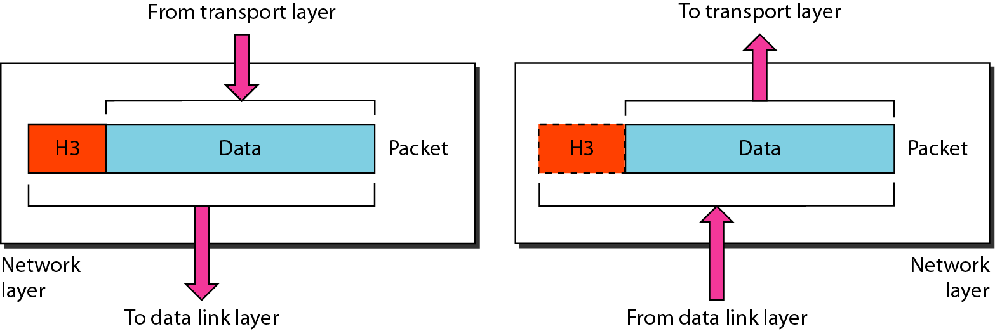
Network layer

Slide 9
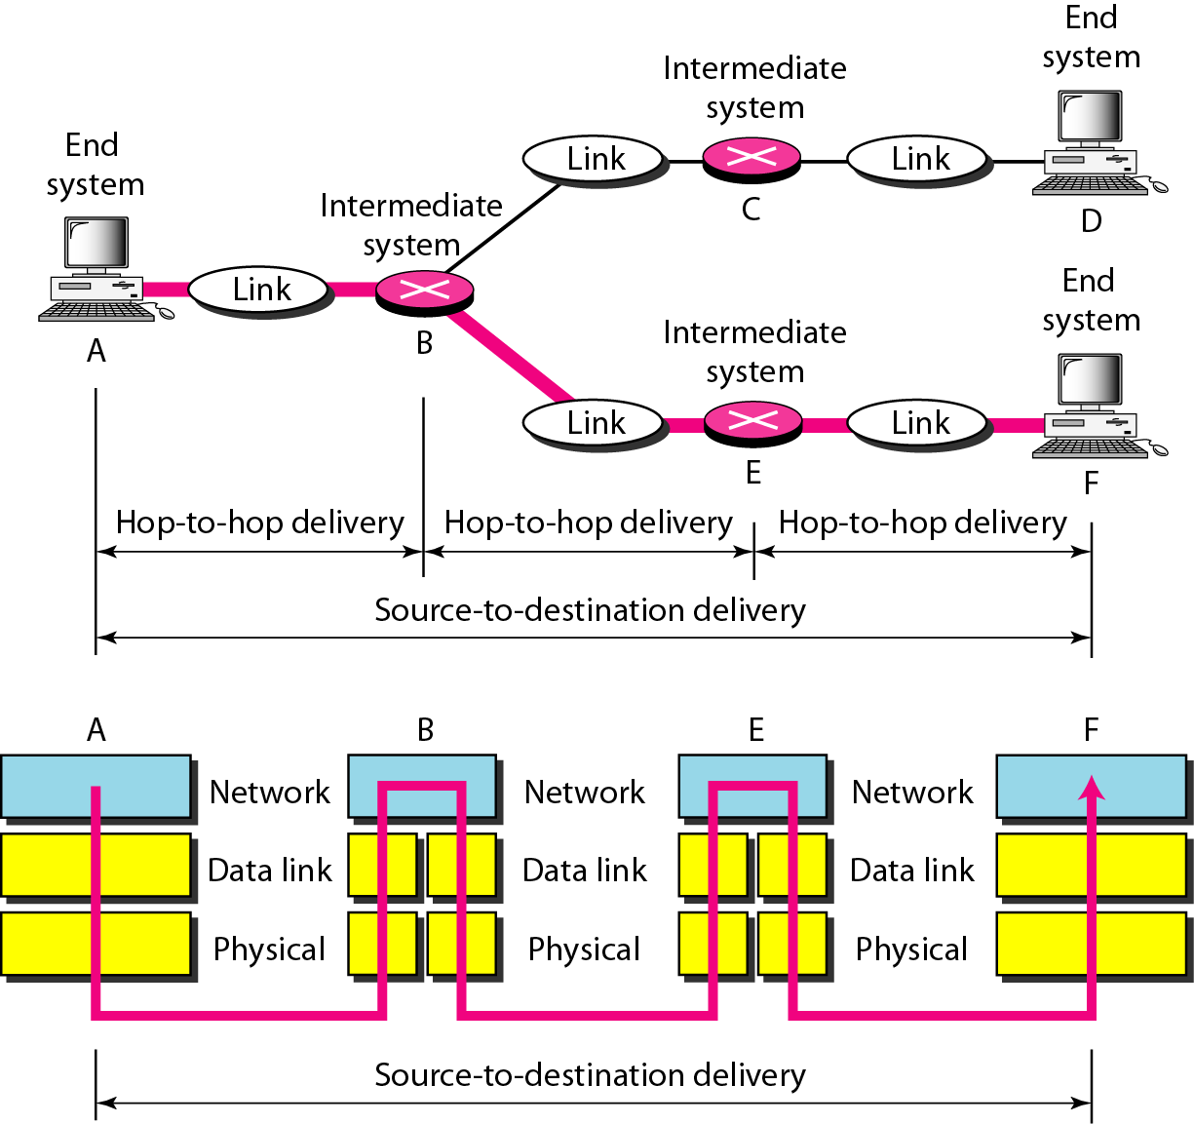
Source-to-destination delivery

Slide 10
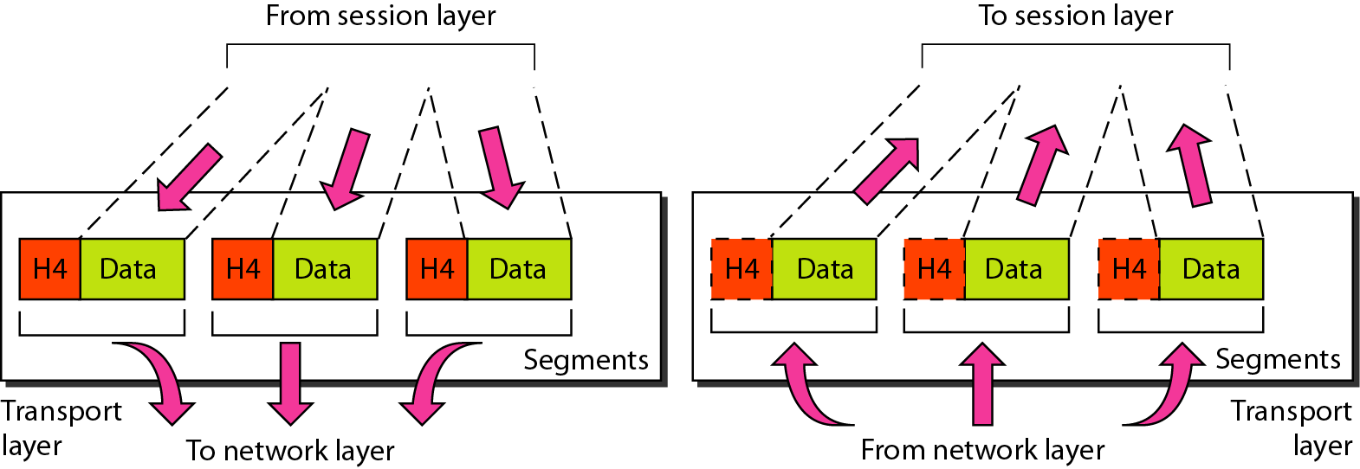
Transport layer

Slide 11
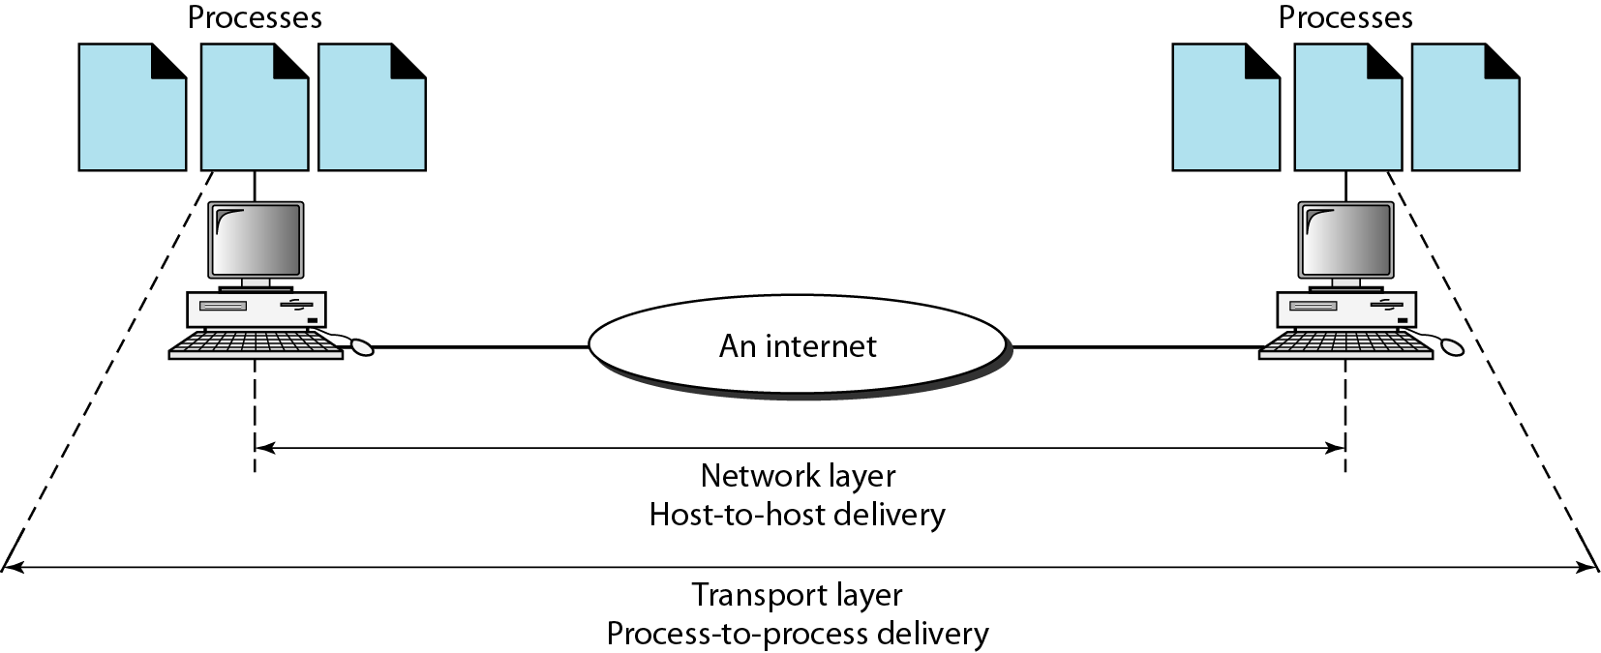
Reliable process-to-process delivery of a message

Slide 12
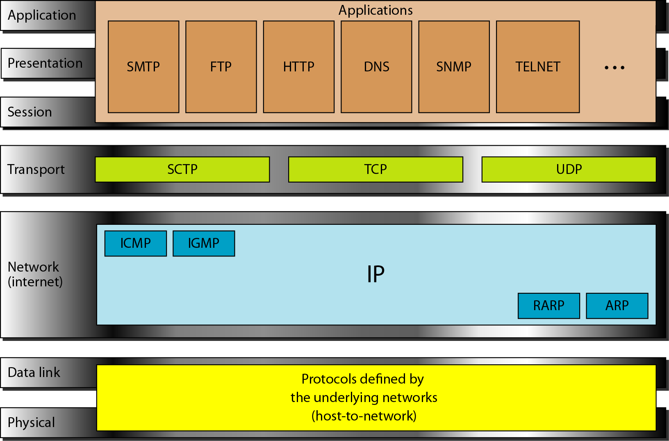
TCP/IP and OSI model

Slide 13
ADDRESSING
Four levels of addresses are used in an internet employing the TCP/IP protocols: physical, logical, port, and specific.

Slide 14
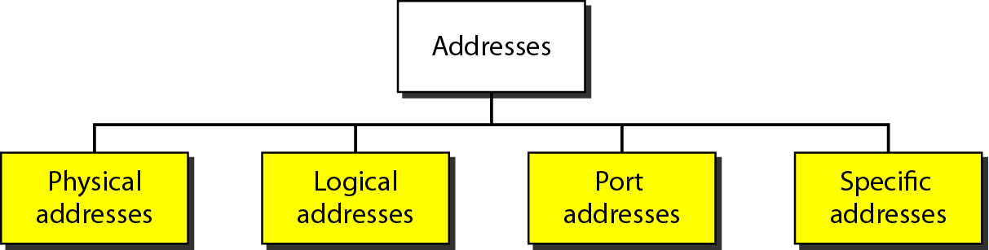
Addresses in TCP/IP

Slide 15
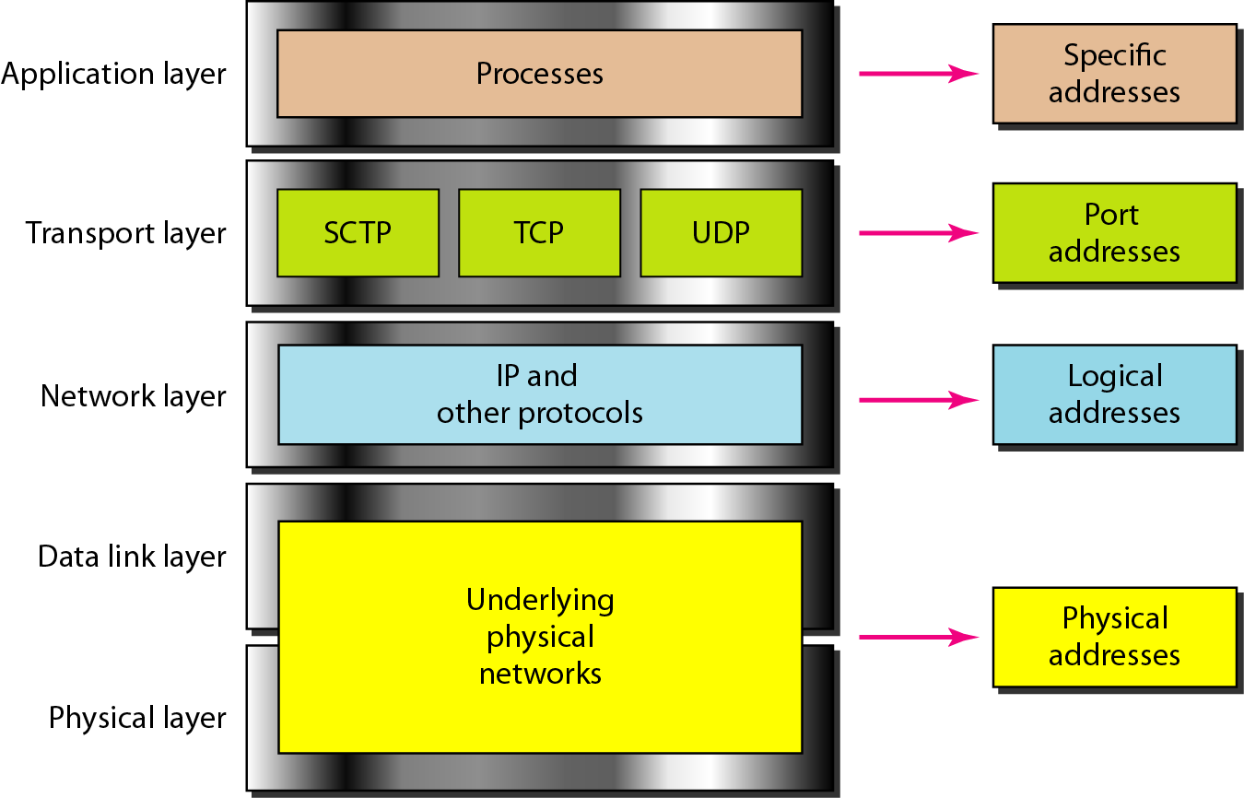
Relationship of layers and addresses in TCP/IP

Slide 16
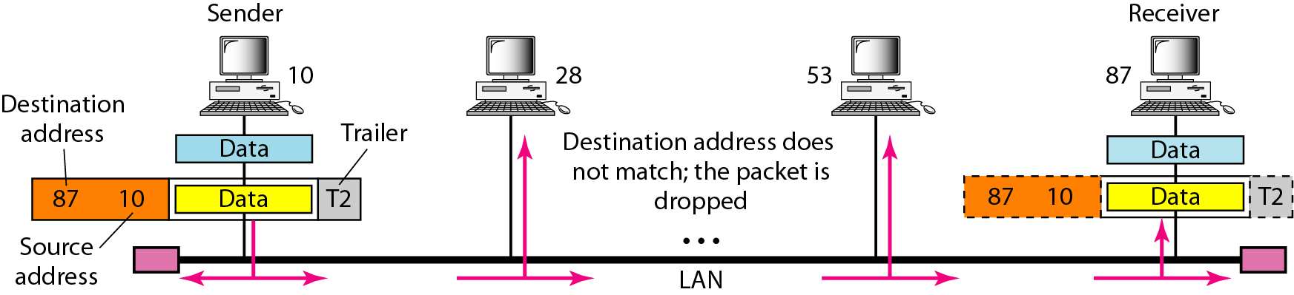
Physical addresses

